Slide 1
Multimedia Computing
By
Minhaz Uddin Ahmed, PhD
Department of Computer Engineering
Inha University Tashkent.
Email: minhaz.ahmed@gmail.com

Slide 2
Content
Arithmetic Coding Algorithm
Scaling and incremental coding
Lossy Compression Algorithms
Advantage and disadvantage
Distortion Theory
MPEG1
MP3
MP4

Slide 3
Arithmetic Coding
Arithmetic coding is a more modern coding method that usually out-performs Huffman coding.
Huffman coding assigns each symbol a codeword which has an integral bit length. Arithmetic coding can treat the whole message as one unit.
A message is represented by a half-open interval [a, b) where a and b are real numbers between 0 and 1. Initially, the interval is [0, 1). When the message becomes longer, the length of the interval shortens and the number of bits needed to represent the interval increases.

Slide 4
ALGORITHM 7.5 Arithmetic Coding Encoder
BEGIN
  low = 0.0; high = 1.0; range = 1.0;
  while (symbol != terminator)
  {
  get (symbol);
  low = low + range * Range_low(symbol);
  high = low + range * Range_high(symbol);
  range = high - low;
  }
  output a code so that low <= code < high;
END

Slide 5
Example: Encoding in Arithmetic Coding
Probability distribution of symbols.
Fig. 7.8: Arithmetic Coding: Encode Symbols “CAEE$”
Symbol | Probability | Range
A | 0.2 | [0, 0.2)
B | 0.1 | [0.2, 0.3)
C | 0.2 | [0.3, 0.5)
D | 0.05 | [0.5, 0.55)
E | 0.3 | [0.55, 0.85)
F | 0.05 | [0.85, 0.9)
G | 0.1 | [0.9, 1.0)
Notes:
d=upper bound – lower bound. Symbol= lower limit: lower limit + d(probability of symbol)

Slide 6
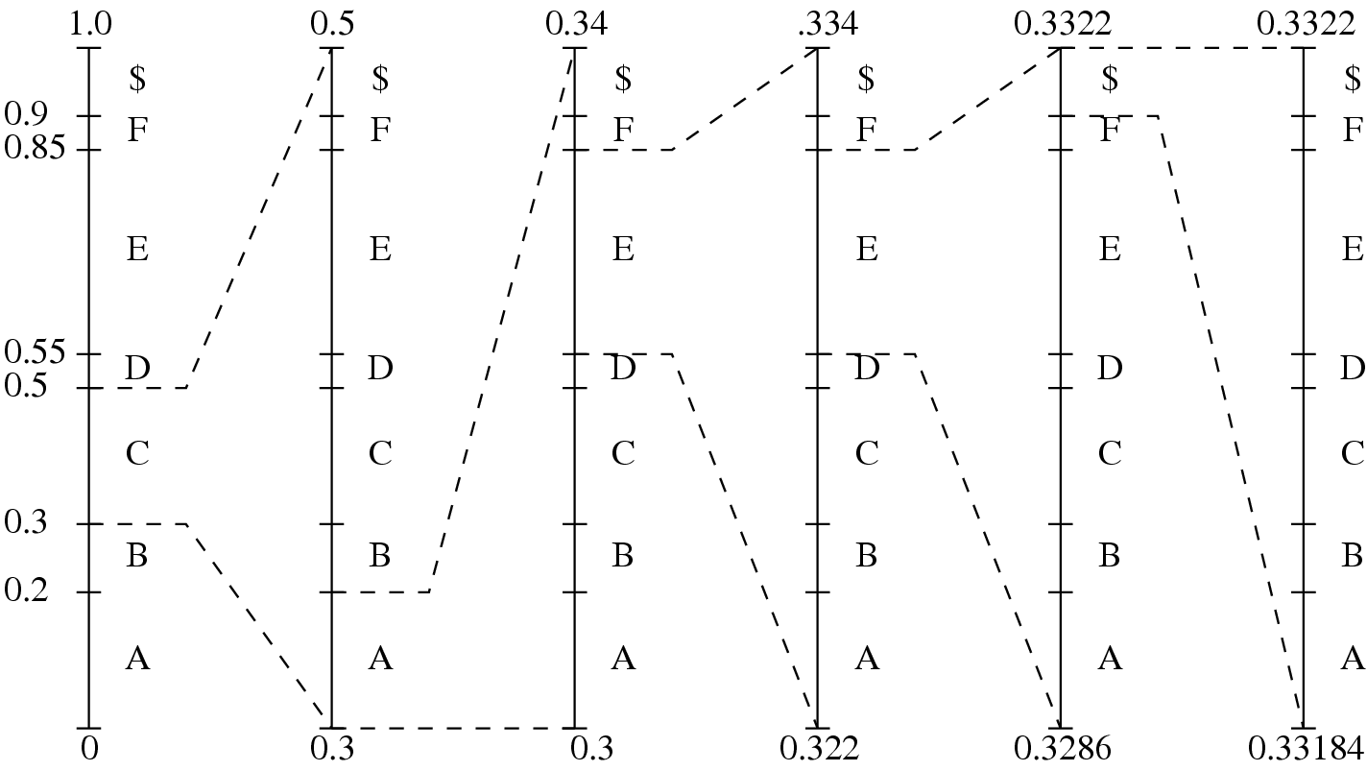
Fig. 7.8(b) Graphical display of shrinking ranges.

Slide 7
Example: Encoding in Arithmetic Coding
(c) New low, high, and range generated.
Fig. 7.8 (cont’d): Arithmetic Coding: Encode Symbols “CAEE$”
Symbol | Low | High | Range
 | 0 | 1.0 | 1.0
C | 0.3 | 0.5 | 0.2
A | 0.30 | 0.34 | 0.04
E | 0.322 | 0.334 | 0.012
E | 0.3286 | 0.3322 | 0.0036
$ | 0.33184 | 0.33220 | 0.00036

Slide 8
PROCEDURE 7.2 Generating Codeword for Encoder
BEGIN
  code = 0;
  k = 1;
  while (value(code) < low)
  {
  assign 1 to the kth binary fraction bit
  if (value(code) > high)
  replace the kth bit by 0
  k = k + 1;
  }
END
The final step in Arithmetic encoding calls for the generation of a number that falls within the range [low, high). The above algorithm will ensure that the shortest binary codeword is found.

Slide 9
ALGORITHM 7.6 Arithmetic Coding Decoder
BEGIN
  get binary code and convert to
  decimal value = value(code);
  Do
  {
  find a symbol s so that
  Range_low(s) <= value < Range_high(s);
  output s;
  low = Rang_low(s);
  high = Range_high(s);
  range = high - low;
  value = [value - low] / range;
  }
  Until symbol s is a terminator
END

Slide 10
Table 7.5 Arithmetic coding: decode symbols “CAEE$”
Value | Output Symbol | Low | High | Range
0.33203125 | C | 0.3 | 0.5 | 0.2
0.16015625 | A | 0.0 | 0.2 | 0.2
0.80078125 | E | 0.55 | 0.85 | 0.3
0.8359375 | E | 0.55 | 0.85 | 0.3
0.953125 | $ | 0.9 | 1.0 | 0.1

Slide 11
Lossy Compression
The compressed data is not the same as the original data but a close approximation of it.
Yields a much higher compression ratio than that of loss less compression

Slide 12
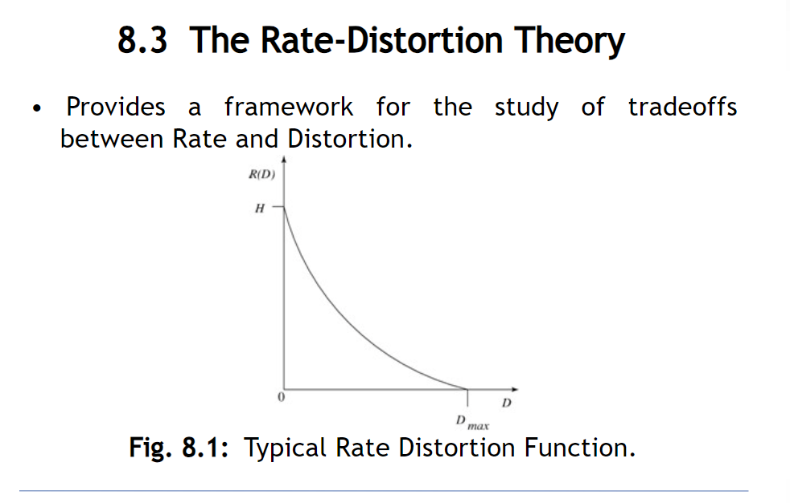
The Rate-distortion Theory

Slide 13
Quantization
Reduce the number of output values to a much smaller set.
Main source of the loss in lossy compression.
Uniform: The type of quantization in which the quantization levels are uniformly spaced is termed as a Uniform Quantization.
Nonuniform : in which the quantization levels are unequal and mostly the relation between them is logarithmic, is termed as a Non-uniform Quantization.

Slide 14
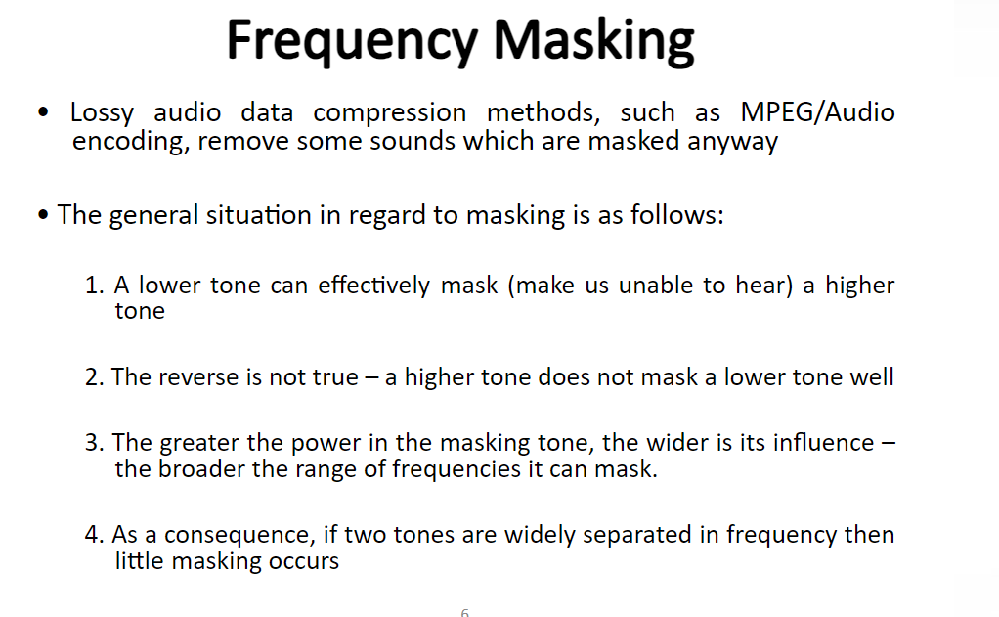
Frequence Masking

Slide 15
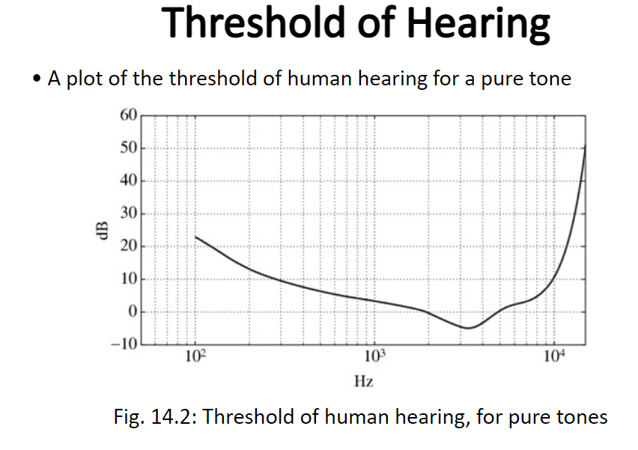
Threshold of Hearing

Slide 16
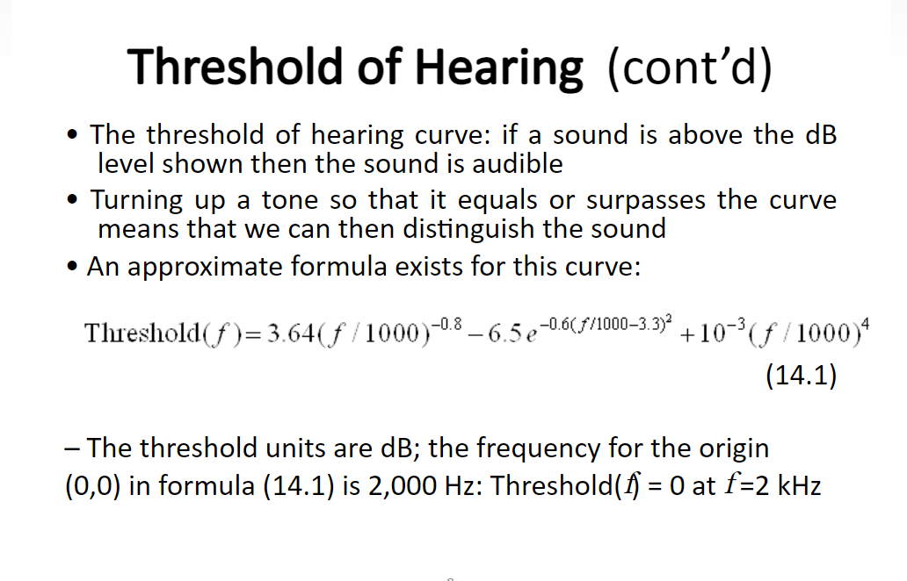
Threshold of Hearing

Slide 17
Why Audio Compression is Needed
to reduce the span between the softest and loudest parts of an audio signal
Data rate = sampling rate * quantization bits * channels (+ control information)
For example (digital audio):
  44100 Hz; 16 bits; 2 channels
  generates about 1.4M of data per second; 84M per minute; 5G per hour

Slide 18
Audio compression format
An audio coding format (or audio compression format) is a content representation format for storage or transmission of digital audio (such as in digital television, digital radio and in audio and video files). Examples of audio coding formats include MP3, AAC, Vorbis, FLAC, and Opus.
A specific software or hardware implementation capable of audio compression and decompression to/from a specific audio coding format is called an audio codec;

Slide 19
Lossless audio coding
Lossless audio coding formats such as FLAC and Apple Lossless are sometimes available, though at the cost of larger files.

Slide 20
Audio compression Lossy
The most widely used audio coding formats are MP3 and Advanced Audio Coding (AAC), both of which are lossy formats based on modified discrete cosine transform (MDCT) and perceptual coding algorithms
Loss of some original audio data, permanently
Lower audio quality, noticeable in certain scenarios
Not suitable for high-end audio applications (music production, audiophiles)

Slide 21
History of MPEG Audio – MP3
First psychoacoustic masking code was proposed in 1979 in AT&T – Bell Labs, Murray Hill.
MP3 based on OCF (optimum coding in frequency domain) and PXFM (Perceptual transform coding)
MPEG-1 Audio Layer III – public release 1993
MPEG-2 Audio III – public release 1995

Slide 22
MPEG-1 Audio
Lossy compression of audio
In late 1980’s ISO’s MPEG group started to standardize
  TV broadcasting
  Use of Audio on CD-ROM (later DVD)
MPEG-1 Audio – 1992
MPEG-2 Audio - 1994
MPEG-1 Audio Layer I, II, III

Slide 23
MPEG-1 Audio Encoding
Characteristics
  Precision 16 bits
  Sampling frequency: 32KHz, 44.1 KHz, 48 KHz
  3 compression layers: Layer 1, Layer 2, Layer 3 (MP3)
    Layer 3: 32-320 kbps, target 64 kbps
    Layer 2: 32-384 kbps, target 128 kbps
    Layer 1: 32-448 kbps, target 192 kbps

Slide 24
MPEG-1 Audio Layer II
Called MP2
Dominant standard for audio broadcasting
  DAB digital radio and DVB digital television
Came out of MUSICAM codecs with bit rates 64-196 kbps
  MUSICAM audio coding - basis for MPEG-1 and MPEG-2 audio
Sampling rates: 32, 44.1, 48 kHz
Bit rates: 32, 48, 56, 64, 80, 96, … 384 kbps
Format: mono, stereo, dual channel, …
  MP2 – sub-band audio encoder in time domain

Slide 25
MPEG-1 Audio Layer III
MPEG-1 Layer III is called MP3 format
  Popular for Internet applications
  Goal to compress to 128 kbps, but can be compressed to higher or lower resulting quality
  Utilization of psychoacoustics
    Scientific study of sound perception .

Slide 26
MP3 (MPEG Audio Layer III)
The Motion Pictures Experts Group (MPEG), a group that works on standards for both audio and video systems. MPEG is a working group that was formed from the existing JPEG (Joint Photographic Experts Group) standard for bit reduction of still pictures. Its goal is to devise a suitable encoding scheme for transmitting moving pictures and sound over various broadcast links and recording them in standard digital storage media. Since moving pictures are often accompanied by sound, MPEG also defined a standard for encoding audio information. In 1992, a standard for audio and video encoding was devised known as MPEG-1.

Slide 27
MP3 (MPEG Audio Layer III)
MP3 stands for MPEG-1 Layer 3. Layers represent a family of coding algorithms. Layer 1 has the lowest complexity compared to the other layers. Layer 2 requires a more complex encoder and decoder and is directed more towards different applications. Thus, Layer 2 is more able than Layer 1 to remove the redundancy in the signal that takes up space. Layer 3 is again more complex and further reduces redundancy and relevance from the data. . The layers are backwards-compatible, which means that any software or hardware capable of decoding Layer 3 audio should also be able to decode Layers 1 and 2.

Slide 28
MP3 (MPEG Audio Layer III)
MPEG-1 Layer 3 is defined as an open standard, so the specification is available to anyone interested in implementing the standard. Since no single company owns the standard, public example source code is available and the format is well defined. Also, driven by the demand for professional use, many MP3 encoders and decoders are readily available for use. This simplifies and accelerates the adoption of MP3 technology. Additionally, the widespread increase in usage of computers fast enough to decode audio, as well as increasingly fast and widely available Internet access, has contributed to the embracing of MP3 music format.

Slide 29
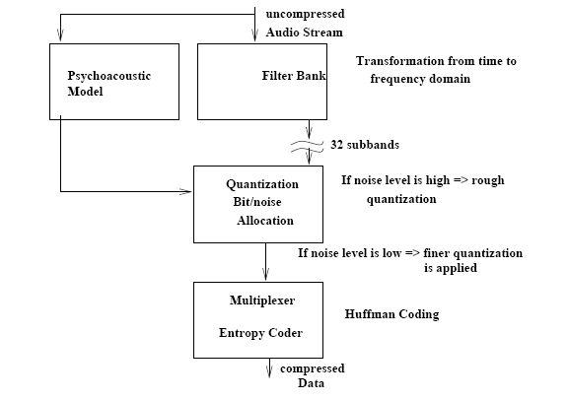
MPEG Audio Encoding Steps

Slide 30
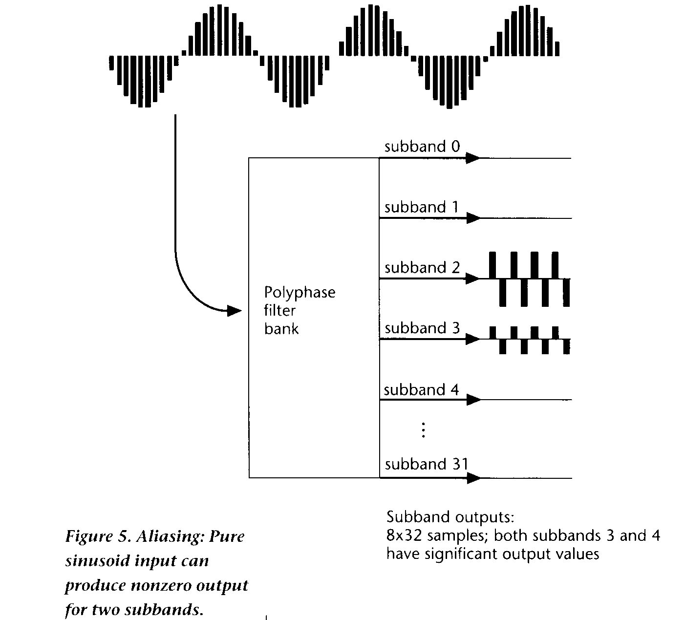

Slide 31
MPEG Audio Filter Bank
Filter bank divides input into multiple sub-bands (32 equal frequency sub-bands)

Slide 32
MPEG Audio Psycho-acoustic Model
Compresses by removing acoustically irrelevant parts of audio signals
Takes advantage of human auditory systems inability to hear quantization noise under auditory masking
  Auditory masking: occurs when ever the presence of a strong audio signal makes a temporal or spectral neighborhood of weaker audio signals imperceptible.

Slide 33
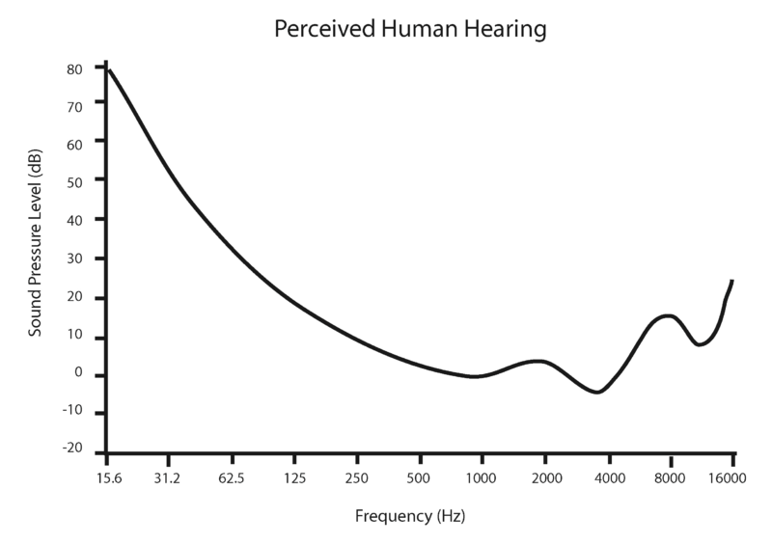

Slide 34
Loudness and Pitch
(Review on Psychoacoustic Effects)
More sensitive to loudness at mid frequencies than at other frequencies
  intermediate frequencies at [500hz, 5000hz]
  Human hearing frequencies at [20hz,20000hz]
Perceived loudness of a sound changes based on frequency of that sound
  basilar membrane reacts more to intermediate frequencies than other frequencies

Slide 35
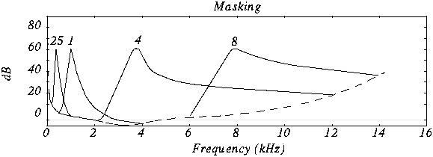
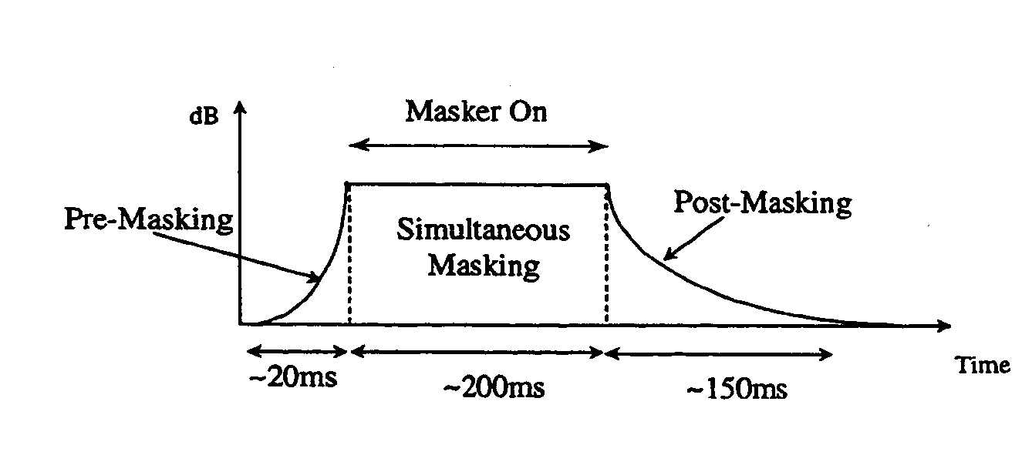
Masking Effects
(Review of Psychoacoustic Effects)
Frequency masking
Temporal masking
Notes:
masking is the reduction of perception of one sound by the presence of another sound.

Slide 36
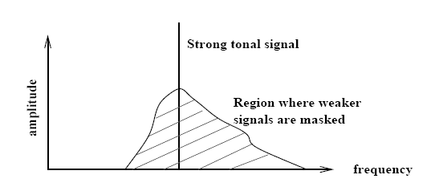
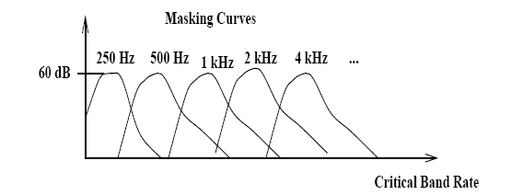
MPEG/audio divides audio signal into frequency sub-bands that approximate critical
bands. Then we quantize each sub-band according to the audibility of quantization
noise within the band

Slide 37
MPEG Audio Bit Allocation
This process determines number of code bits allocated to each sub-band based on information from the psycho-acoustic model
Algorithm:
  Compute mask-to-noise ratio: MNR=SNR-SMR
    Standard provides tables that give estimates for SNR resulting from quantizing to a given number of quantizer levels
  Get MNR for each sub-band
  Search for sub-band with the lowest MNR
  Allocate code bits to this sub-band.
    If sub-band gets allocated more code bits than appropriate, look up new estimate of SNR and repeat step 1
Notes:
SMR=Signal to Mask Ratio , Mask to Noise Ratio

Slide 38
Audio Quality
Bitrate
  With too low bit rate, we get compression artifacts
    Ringing
    Pre-echo – sound is heard before it occurs. It is most noticeable in impulsive sounds from percussion instruments such as cymbals
      Occurs in transform-based audio compression algorithms
Quality of encoder and encoding parameters
  Constant Bit rate encoding
  Variable Bit rate encoding

Slide 39
MP3 (MPEG Audio Layer III)
A psychoacoustic model refers to an analysis of an audio signal that determines the amount of noise masking available based on frequency and loudness.
Uses psychoacoustic models to eliminate sounds humans cannot hear.
Reduces bitrate by focusing on the most important audio frequencies.
High compression ratio. Suitable for music and voice compression with moderate to high quality

Slide 40
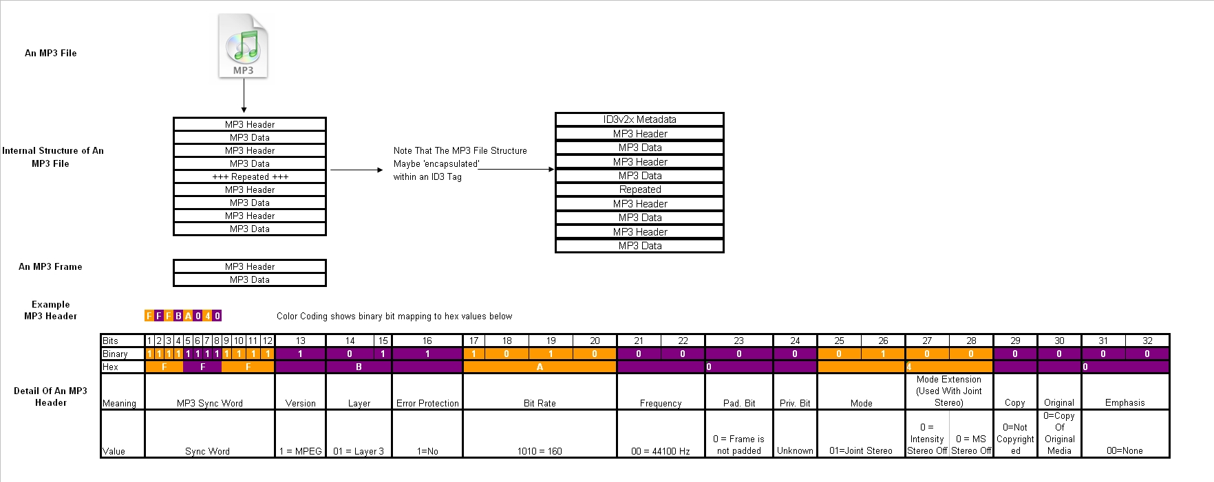
MP3 Audio Format
Source: http://wiki.hydrogenaudio.org/images/e/ee/Mp3filestructure.jpg

Slide 41
MPEG Audio Comments
Precision of 16 bits per sample is needed to get good SNR ratio
Noise we are getting is quantization noise from the digitization process
For each added bit, we get 6dB better SNR ratio
Masking effect means that we can raise the noise floor around a strong sound because the noise will be masked away
Raising noise floor is the same as using less bits and using less bits is the same as compression

Slide 42
MPEG Audio – MP3
1997 – mp3.com – offering thousands of MP3s created by independent artists for free
1999 – Napster MP3 peer-to-peer file sharing
Problem: copyright infringement
Authorized services: Amazon.com, Rhapsody, Juno Records, ..

Slide 43
How Does Lossy Audio Compression Work?
Perceptual coding: Only keep audio data that humans can hear
Use of algorithms (e.g., MP3, AAC) to remove redundant or less important sounds
Example of human hearing limitations (high-frequency sounds)

Slide 44
Advantages of Lossy Compression
Small file sizes, saving storage space
Faster transmission over the internet (streaming, downloading)
Suitable for consumer-grade audio where perfect fidelity isn't necessary

Slide 45
Applications of Lossy Compression
Music streaming (Spotify, Apple Music)
Podcasts
Audiobooks
Online videos (YouTube)
Video conferencing (Zoom, Skype)

Slide 46
Criteria for Good Standard
Achieve desired outcome
Be comprehensible
Allow efficient implementation
Support competition
Give benchmark tests
Be supported by industry
Be good for end users
….
Two models:
implement first, then standardize
standardize first, then implement

Slide 47
MPEG-4 Audio (Successor of MP3)
Advanced Audio Coding (AAC) – now part of MPEG-4 Audio
Inclusion of 48 full-bandwidth audio channels
Default audio format for iPhone, iPad, Nintendo, PlayStation, Nokia, Android, BlackBerry
Introduced 1997 as MPEG-2 Part 7
In 1999 – updated and included in MPEG-4

Slide 48
MPEG-4 Audio
Bit-rate 2-64kbps
Scalable for variable rates
MPEG-4 defines set of coders
  Parametric Coding Techniques: low bit-rate 2-6kbps, 8kHz sampling frequency
  Code Excited Linear Prediction: medium bit-rates 6-24 kbps, 8 and 16 kHz sampling rate
  Time Frequency Techniques: high quality audio 16 kbps and higher bit-rates, sampling rate > 7 kHz

Slide 49
MPEG-4 Audio
(AAC’s Improvements over MP3
Advanced Audio Coding in MPEG-4
More sample frequencies (8-96 kHz)
Arbitrary bit rates and variable frame length
Higher efficiency and simpler filterbank
  Uses pure MDCT (modified discrete cosine transform)
  Used in Windows Media Audio

Slide 50
MPEG-4 Audio
Variety of applications
  General audio signals
  Speech signals
  Synthetic audio
  Synthesized speech (structured audio)

Slide 51
MPEG-4 Audio Part 3
Includes variety of audio coding technologies
  Lossy speech coding (e.g., CELP)
    CELP – code-excited linear prediction – speech coding
  General audio coding (AAC)
  Lossless audio coding
  Text-to-Speech interface
  Structured Audio (e.g., MIDI)

Slide 52
MPEG-4 Part 14
Called MP4 with Extension .mp4
Multimedia container format
Stores digital video and audio streams and allows streaming over Internet
Container or wrapper format
  meta-file format whose spec describes how different data elements and metadata coesit in computer file

Slide 53
Conclusion
[edit] Notes
MPEG Audio is an integral part of the MPEG standard to be considered together with video
MPEG-4 Audio represents an major extension in terms of capabilities to MPEG-1 Audio

Slide 54
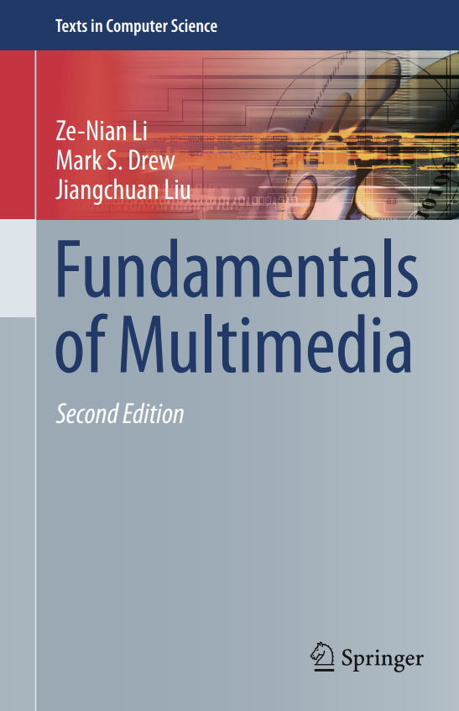
Reference
Chapter 8

Slide 55

Question

Slide 56

Thank you

